Slide 1

Slide 1
COURSERA
IBM Applied Data Science Capstone Project
Recommend places to open a new Indian Restaurant in New Delhi, India.
Piyush Jain
January,2020

Slide 2

Slide 2
Business Problem?
To open a new restaurant, the one of the most important factors which contribute to the success of any restaurant is its LOCATION.
According to the CNBC report, 45% of restaurant failure is because the owner chose bad location for the restaurant.

Slide 3

Slide 5
Business Requirement???
To analyze and select the best locations in New Delhi, India to open a new Indian restaurant.
Four important factors to choose the best location:
Frequency of the Indian Restaurants in the location.
Frequency of the Restaurants in the location.
Population Base
Accessibility
Parking Facility

Slide 4

Slide 6
DATA Resources
Following are the data resources which define the scope of the project.
Excel file from the website https://simplemaps.com/data/in-cities which include the Indian Geocodes for the places in Delhi.
Geocoder package for latitude and longitude coordinates.
We will be using the Foursquare API for this project. The reason for using the Foursquare API is because it has one of the largest databases of 105+ million places and is used widely by many developers too. Foursquare will provide different categories of the venues data and Indian Restaurants is among one of the categories, we are interested in for this project. Foursquare API to get the venue details related to the Indian restaurants.

Slide 5
Slide 7
Methodology
Project Methodology
Upload the excel file to IBM Watson Studio and read the file using Pandas.
Apply the Data cleansing and pre processing techniques to extract the locations for Delhi.
Use the Geocoder package to get the longitude and latitude of the address mentioned in the Pandas Data frame.
Take the longitude and latitude of the locations and use the Foursquare API to get the venue details, venue categories, their longitude and latitude and many more features.
Group the data by neighborhood and taking the mean of the frequency of the occurrence of each venue category.
Filter the category by Indian Restaurants.
Perform Machine Learning Algorithm – use K means algorithm.
Use the Elbow Method to get the optimum value of K and apply to K means.
Visualize the result of the clusters on the map using the Folium Maps.

Slide 6
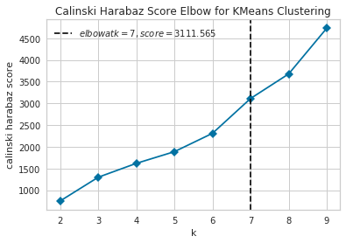
Slide 12
Apply Elbow Method
Before applying the K means algorithm, we must know what the optimum value of K. There are quite few methods available to know the optimum value of K and we will be using the Elbow method to know the value of K suited for the K means algorithm. The value of K is 7.

Slide 7
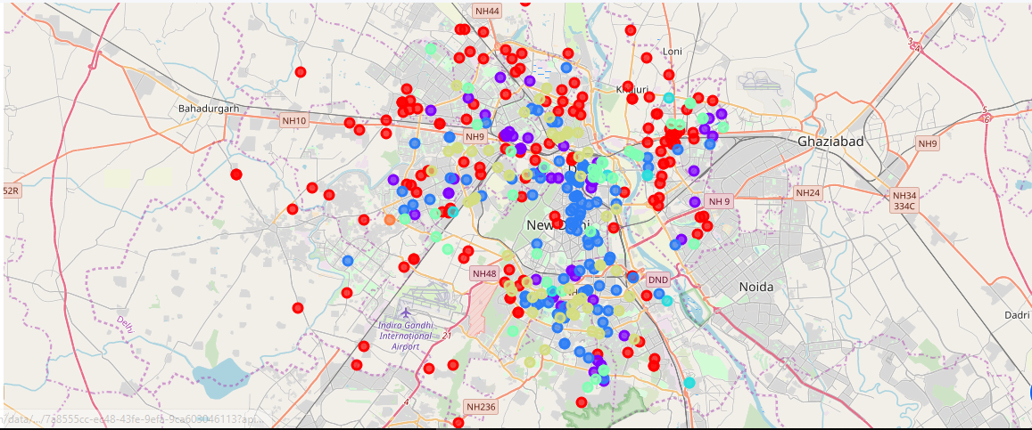
Slide 12
Results
The results from the K-means clustering shows that Cluster 1 have the least concentration of Indian restaurants
Clusters with least number of Indian Restaurants – Cluster 0
Clusters with moderate number of Indian Restaurants – Clusters 1, 2 and 5.
Clusters with high number of Indian Restaurants – Clusters 3, 4 and 6

Slide 8
Slide 12
Discussions
Most of the Indian restaurants are located in the South and Central Delhi.
Highest number of Indian Restaurants is in the places under clusters 3, 4 and 6
.
Cluster 0 has very low numbers of Indian restaurants. This represents a good opportunity to big food chains or the persons thinking to open a new Indian Restaurant in the areas under cluster 0 as there will be a less competition compare to other areas.
Clusters 1,2 and 5 have moderate number of Indian Restaurants. People might think to open a new restaurant in these places.
The people avoid the areas mentioned in the clusters 3, 4 and 6
which already have high competition among them.

Slide 9
Slide 12
Recommendations
In this project, we consider only one factor i.e. frequency of the occurrence of the Indian Restaurants. There are some other important factors as well like-
Population base
Income of residents
Parking facility
Accessibility of the area
All these factors could influence the location decision to open a new Indian Restaurant. Future research could use of these factors too to make more accurate recommendation of the location to open a restaurant.

Slide 10
Slide 12
Conclusion
In this project, we have gone through of identifying the business problem, specifying the data resource, prepare the data and perform the machine learning algorithms to recommend the best places to open a new Indian restaurant. To answer the question raised in the Business problem is to recommend the places in the Cluster 0 which have quite less concentration of the restaurants and with very less competition. Avoid the places in clusters 3, 4 and 6as there are over supply of the restaurant with high competition.

Slide 11
Slide 15
THANK YOU!
REACH me at:
Piyush Jain
piyushjain11@ymail.com

